Slide 1
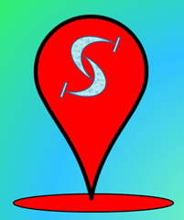

Splash Awards
ScavCache
Team Dark Falcon, consisting of:
Qiang Jiayuan (1J),
Ethan Koh(1J),
Chou Bi Yu (1B)

Slide 2
91%
post a photo of themselves
up from 79% in 2006

Slide 3
Opportunities
Unawareness of problems when sharing information online
Younger generation understand more about the risks
Spread the message to others as well

Slide 4

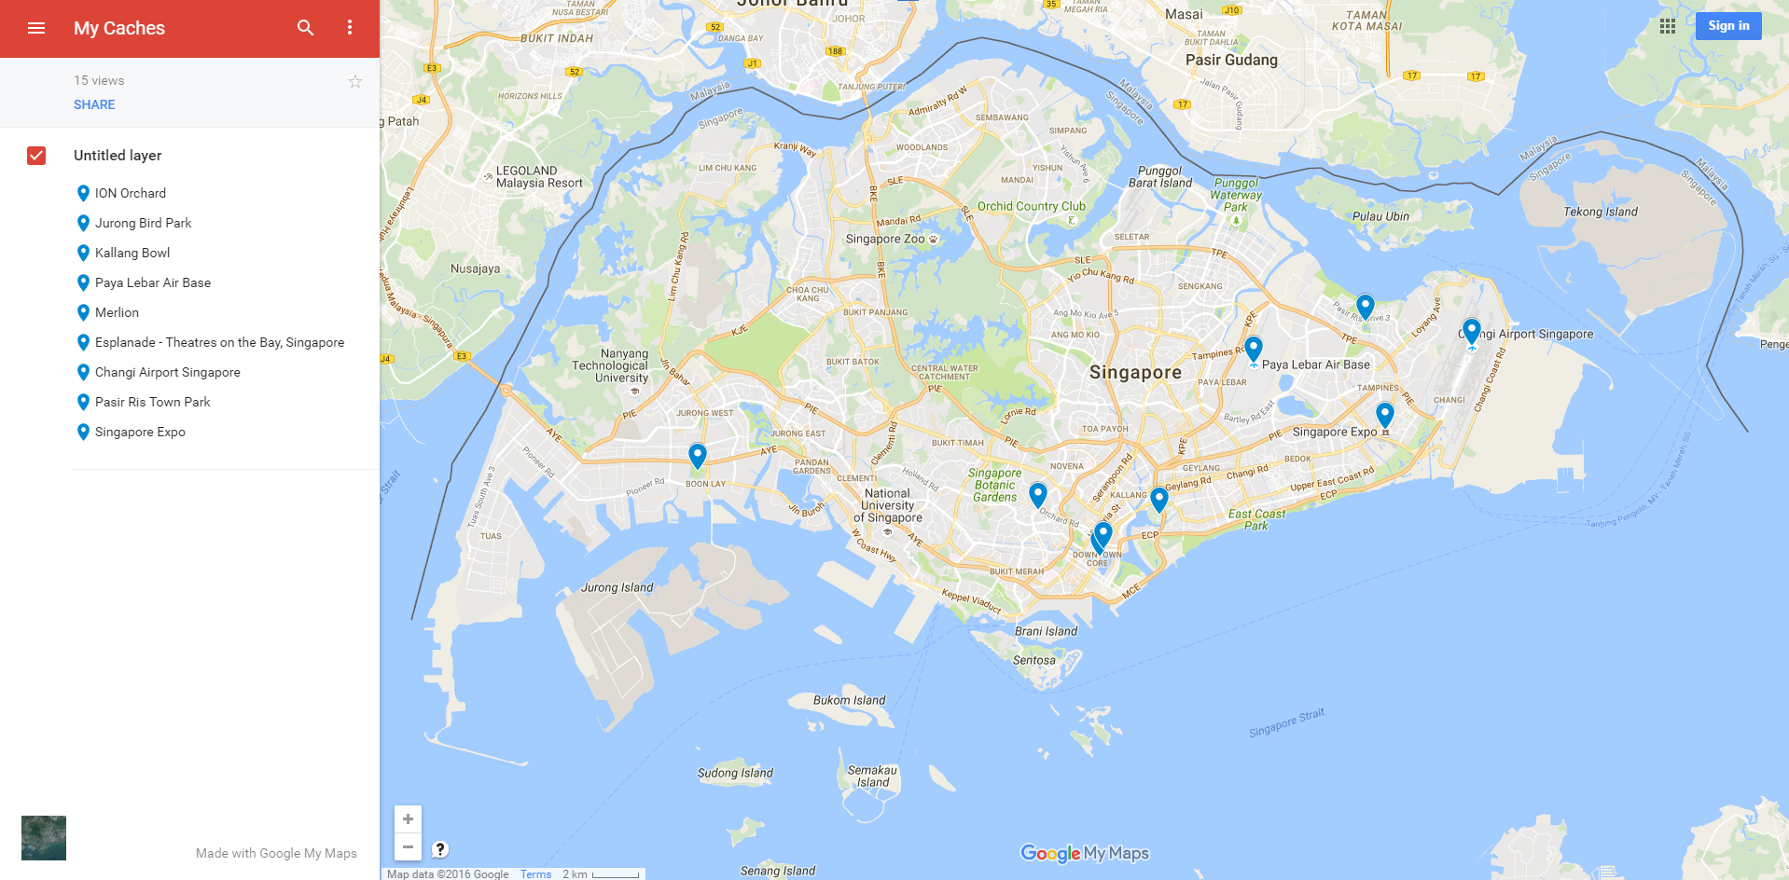

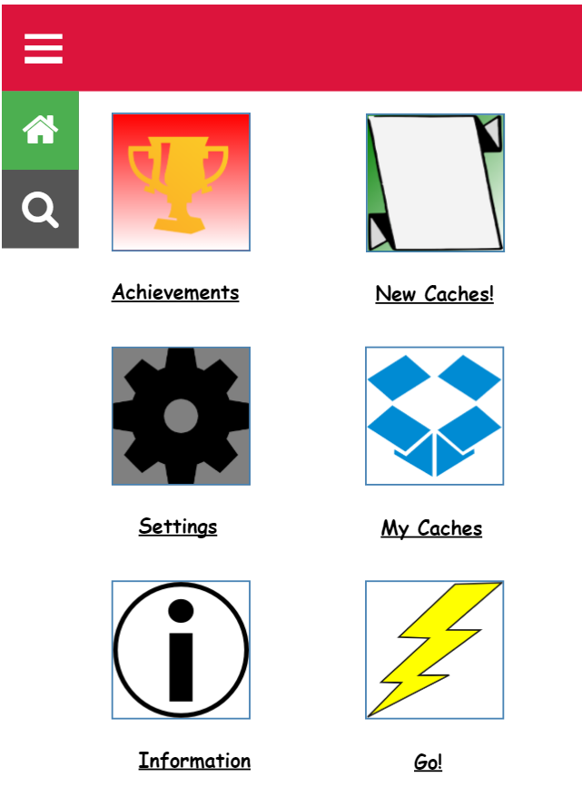
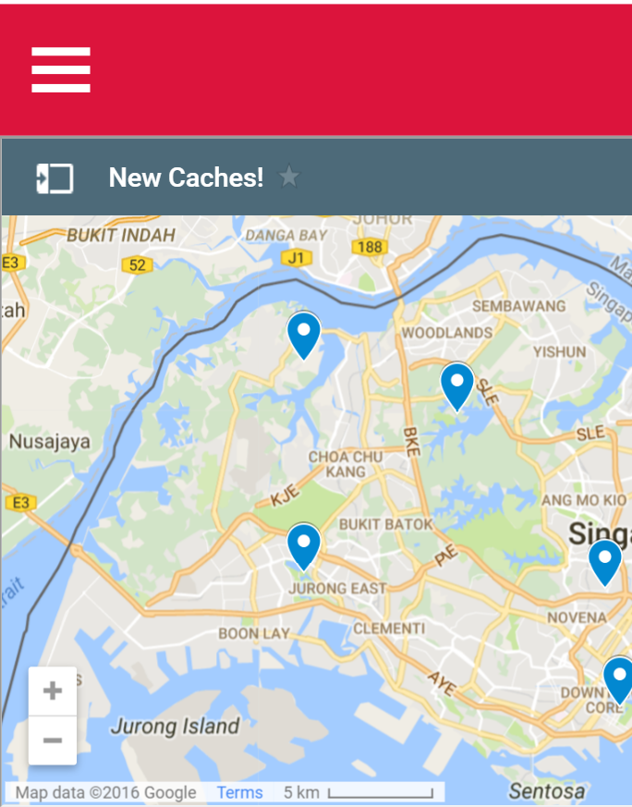
ScavCache’s
Main Screens

Slide 5


Feasibility
Uses web technology to run the program
Google Javascript API
Facebook API

Slide 6

Uniqueness
Players have to look at their screen frequently
Only requires a quick peek to confirm if it is the vicinity
Alert you when you are near one
Notes:
However, our app is different. To prevent the problem that some players will run into incidents when playing, as in Pokemon: Go players often have to look at their screen when catching pokemons while walking so they do not miss any encounters. ScavCache is different in the way that it always is there; that is to say that it will always be visible and thus only requires a quick peek to confirm if it is the vicinity. It would also alert you when you are near one.?

Slide 7


Creativity
“Cache”: a hidden "box" containing items for users
“Scav” : Scavenger

Slide 8

Relevance to theme
Minimises the number of people
Don’t know the risks of sharing personal
information online
Raising awareness of risks of sharing personal information online

Slide 9


Impact on Target Audience: Teens
Attend scavenger hunts when they are young: Childhood days
Know more about Singapore’s less well known landmarks

Slide 10



Summary
“Scavenger Hunt” with hints
Location tracked by GPS
Complete a small quiz about sharing personal information online

Slide 11
Thanks!

